Slide 1
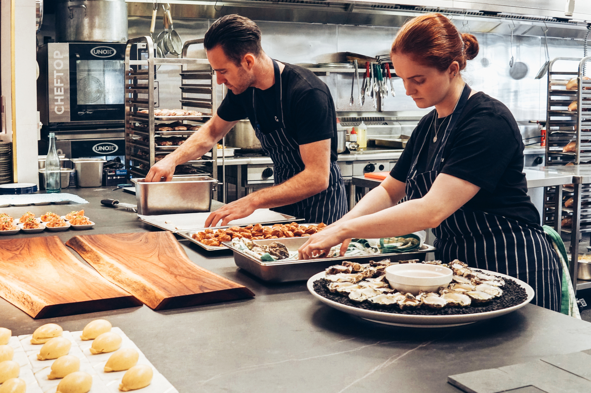


TEAM ROME
MKTG-5300-0LA
“ Life's too short to eat anywhere else. ”

Slide 2



Rome Team Members
Nigerian
Abiola Ogunleye
Indian
Mohammed Abdul Rafay
Bangladeshi
Mehedi Hasan
Nigerian
Favour Mike-Ewewie
Indian
Amaan Khan

Slide 3
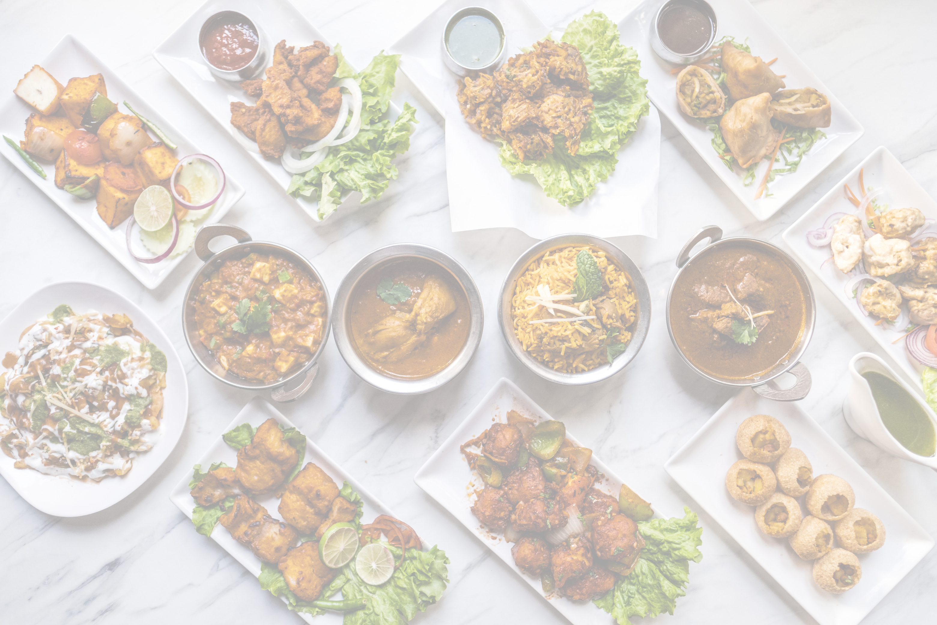

INTRODUCTION
In 1965, Ruth Fertel mortgaged her home to invest in a New Orleans steak house.
Ruth a self-taught restaurant business owner, took risks expanding her business using an untested business model - the Franchise model.
A true pioneer and risk taker birthed the now over 93 restaurants - 42 company owned and 51 franchise owned in 85 US and 10 International locations.

Slide 4

Five Critical Success Factors
Rank
Business Difficulty
Business environment
Urban Population
pH Factor
GDP Per Capita
Market size
Indication of affordability
Beef Consumption
Direct demand indicator

Slide 5
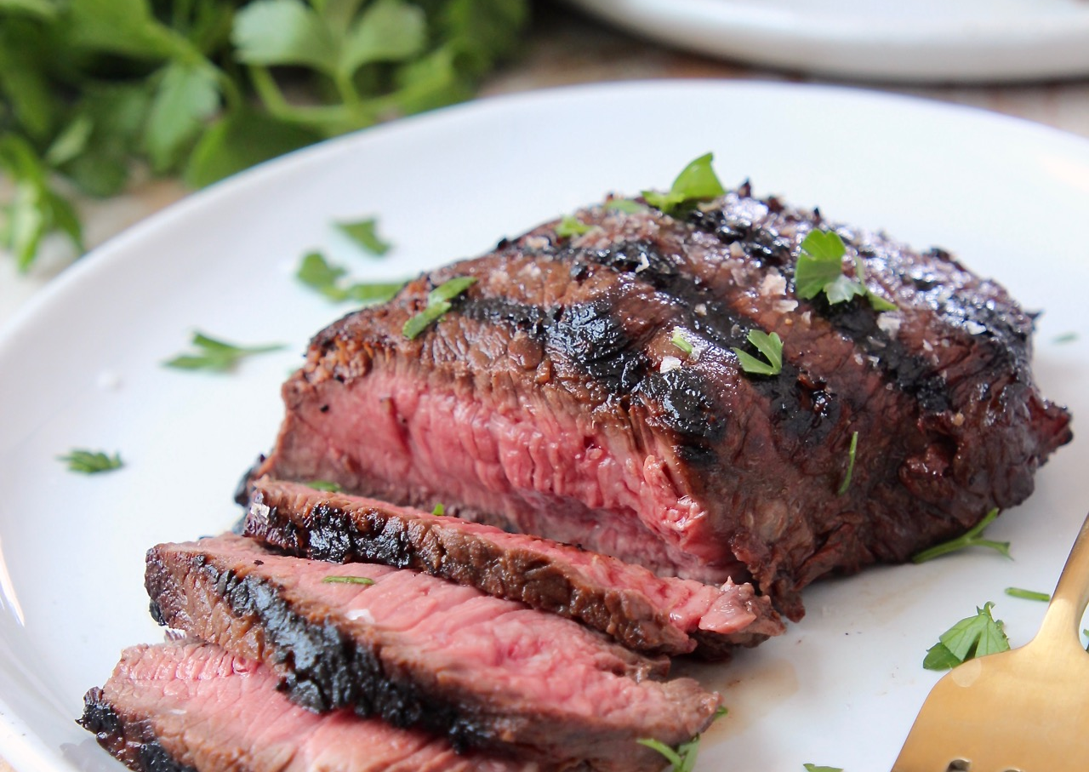
Beef Consumption
Key demand driver.
An indicator of potential consumption of beef and measures demand for high-end beef.

Slide 6
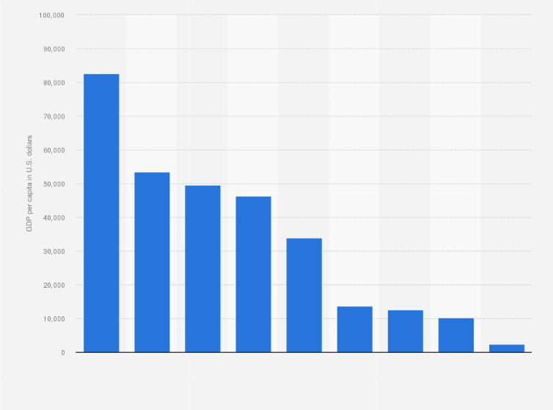
GDP Per Capita
Purchasing power.
Represents affluence and spending power of the population.

Slide 7

Urban Population
Market size.
Measures accessibility and prospective customers. The closer potential customers, the increasing demand to dine out.

Slide 8

Business Difficulty
pH factor.
Captures the operational aspects involved in running the business and influences the cost of expansion.
Lower difficulty is better.

Slide 9

Ranking
Business environment.
The lower the rank, the better business environment it is.

Slide 10
Countries for Consideration
LUXEMBOURG
AUSTRALIA
IRELAND
CHILE
QATAR
DENMARK
NORWAY
SWITZERLAND
ISRAEL
HONG KONG

Slide 11



FACTOR RATING
 | Beef Consumption (0.25) | GDP Per Capita (0.25) | Urban Population (0.20) | Business Difficulty(pH) (0.15) | Rank (0.15) | Index
 | 0.049 | 0.0524 | 0.0153 | 0.222 | 0.084
Luxembourg | 0.83 | 1 | 0.00064 | 2 | 0.25 | 0.79
Ireland | 0.60 | 0.84 | 0.003 | 1 | 0.76 | 0.62
Israel | 1 | 0.44 | 0.0099 | 1 | 0.64 | 0.61
Qatar | 0.43 | 0.69 | 0.0029 | 2 | 0.2 | 0.61
Norway | 0.44 | 0.84 | 0.005 | 1 | 0.92 | 0.61
Australia | 0.67 | 0.52 | 0.025 | 1 | 0.86 | 0.58
Chile | 0.72 | 0.09 | 0.0019 | 2 | 0.39 | 0.56
Denmark | 0.54 | 0.52 | 0.005 | 1 | 0.97 | 0.56
Switzerland | 0.44 | 0.73 | 0.007 | 1 | 0.63 | 0.54
Hong Kong | 0.58 | 0.36 | 0.008 | 1 | 0.97 | 0.53

Slide 12
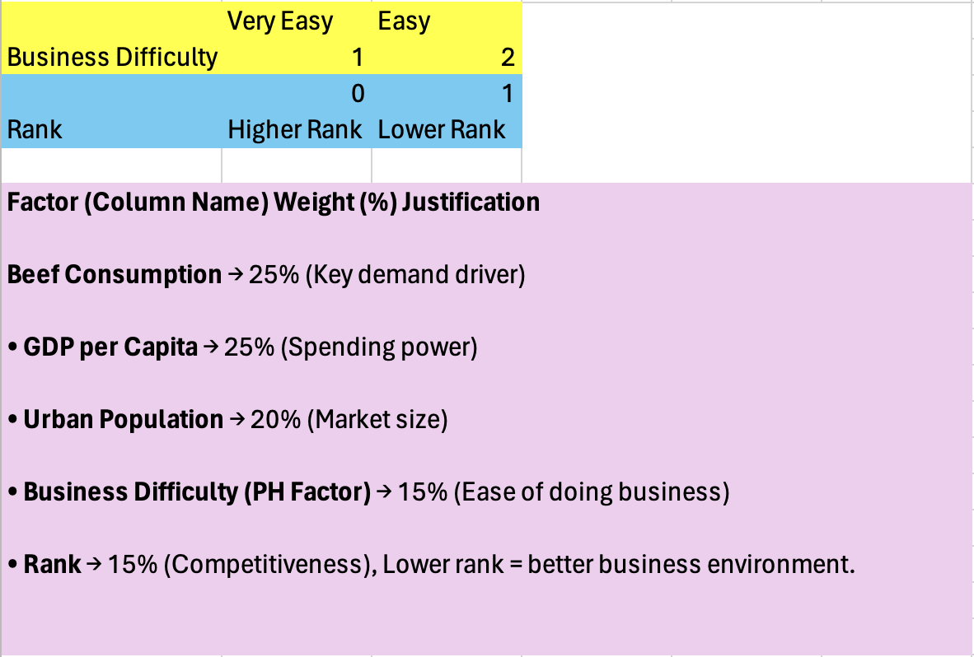
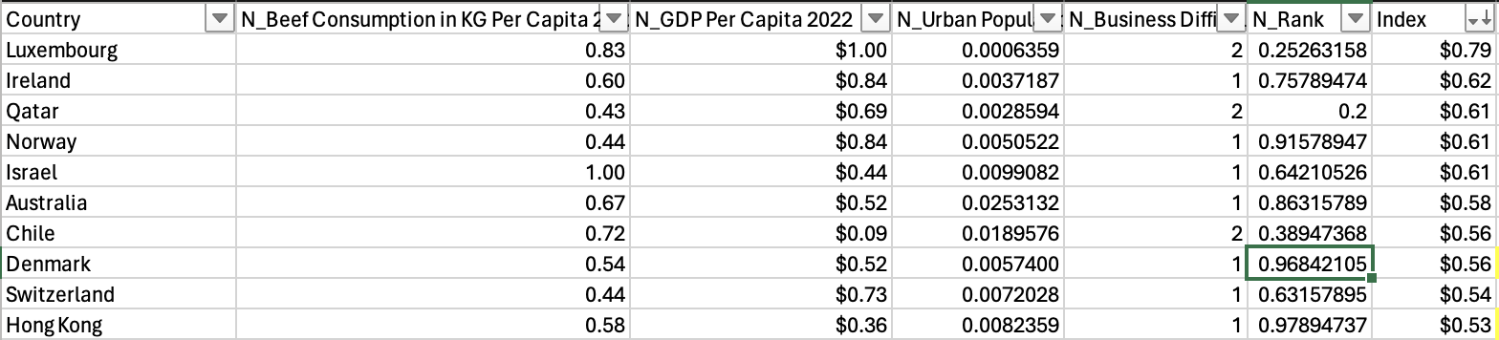
Factor Calculations

Slide 13



TOP 3 COUNTRIES
LUXEMBOURG – 0.79 Index
IRELAND – 0.62 Index
ISRAEL – 0.61 Index
Best for ultra high-end dining
Best mix of wealth, demand and ease of business
Best for sheer beef consumption and accessibility

Slide 14
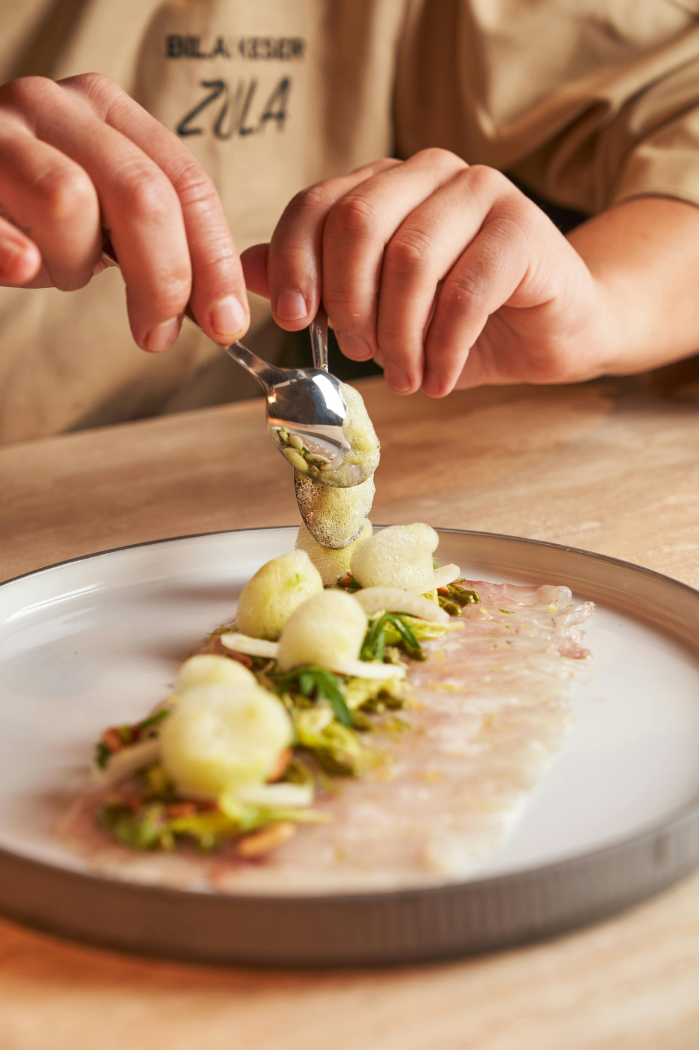

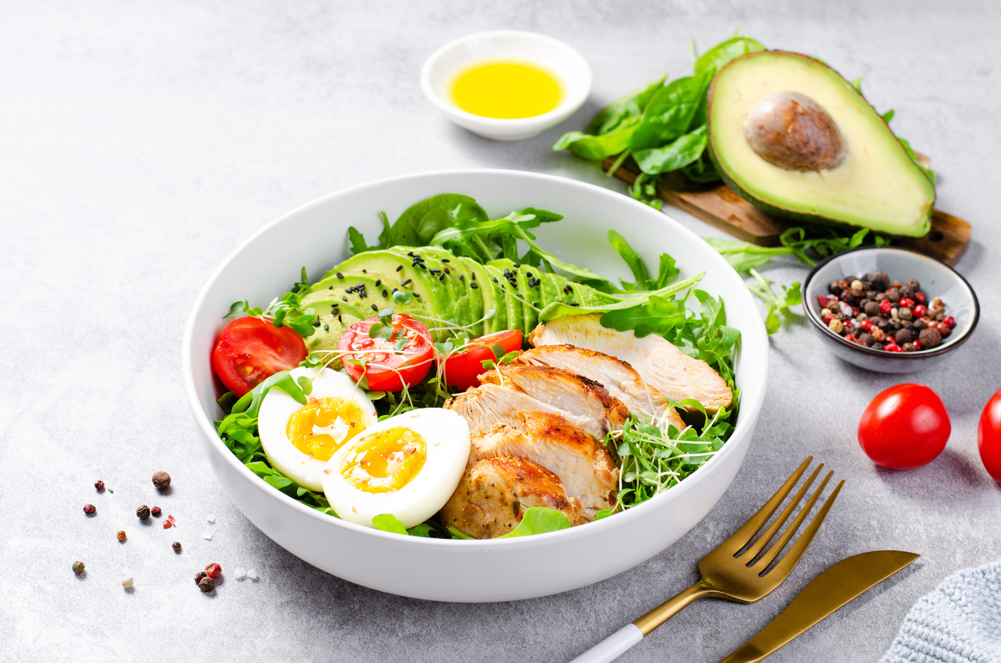

Further Research for Ruth’s Chris
International Franchise Framework
Develop a prototype from existing International Franchises
Regional and continent-specific External Factors franchise business indicators

Slide 15

THANK YOU

